Slide 1


Why
Finland
for pharmaceutical R&D?

Slide 2
This slide set has been prepared by
Pharma Industry Finland (PIF) Clinical Trials Expert Group, consisting of almost 10 experts from PIF member companies
The slide set is free to be used in promoting clinical research in Finland
If you have any comments or questions, please contact PIF Senior Advisor Pauliina Ehlers; pauliina.ehlers@laaketeollisuus.fi

Slide 3

Land of a Thousand Possibilities

Slide 4



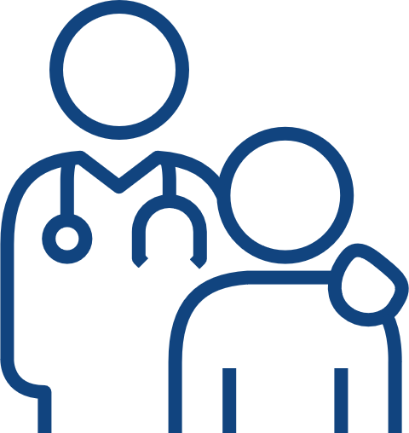


The Power of a Functional Ecosystem
Land of:
  specialized cancer centers
  neurology know-how
  high-quality vaccine research
  pediatric expertise
  phase I research specialists
  private sector
Well-functioning
healthcare system
Electronic patient records
Digitally skilled & engaged people & culture of trust
Genomic data & biobanks
Government backing

Slide 5

Well-functioning Healthcare
5,6 million inhabitants¹
Pharmaceutical industry investments have doubled since 2019²
Finnish Government is committed to the national target of raising Finland's R&D expenditure to 4% of GDP by 2030³
A survey conducted in 2024 showed that clinical trials bring substantial benefits
both to the patients and society: societal value of one clinical drug trial averages approximately €10 million⁴
Well-functioning collaboration with regulatory authorities – two-way communication with local authority and national ethics committee, authorities support study sponsors, academia and clinical trial sites in order to reach the common goals
Well-functioning
healthcare system
Electronic patient records
Digitally skilled & engaged people & culture of trust
Genomic data & biobanks
Government backing
1. https://stat.fi/en/publication/clmixlq2e5fnt0bw60d4l2t7g 2. Pharma Industry Finland investment survey 2023 3. Finnish Governmental program 2023 4. Study ”Value of Clinical Trials”, Pharma Industry Finland 2024

Slide 6

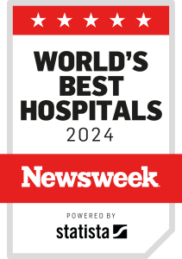
Well-functioning Healthcare
Strong Nordic collaboration in several therapeutic areas (Denmark, Finland, Sweden, Norway =
28 million inhabitants)
Finnish university hospitals rank high in Newsweek 2024 listing (2400 hospitals, across 30 countries), e.g.
  50. Helsinki
  121. Turku
  126. Tampere
Finnish study participants are
  Committed
  willing to travel to the clinical
  trial site from other parts
  of the country
  Digital-savvy
  actively seeking information about recruiting studies from
  the websites of centers and authorities
Well-functioning
healthcare system
Electronic patient records
Digitally skilled & engaged people & culture of trust
Genomic data & biobanks
Government backing

Slide 7


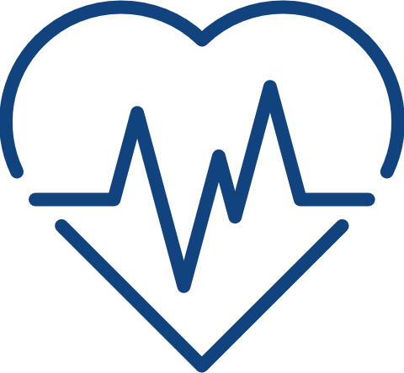


Finnish Population, Public Diseases
Cancer
Cardiovascular diseases
Diabetes
There are over 35,000 new cases annually, and more than 13,000 cancer deaths.
Various tumors were the most common cause of death among working-age Finns and the second most common cause of death among all Finns in 2020.
As the population ages, more people are developing cancer, and it is predicted that by 2035 there will be over 30% more new cancer cases, approximately 46,000.
Cardiovascular diseases cause almost half
of all deaths among people of working age in
Finland.
In 2018, about 173,000 Finns had a special rightto reimbursement for coronary heart disease.
Every other adult has either an antihypertensive medication or increased blood pressure. This means more than 2 million people.
More than 3 million Finns suffer from lipid disorders, i.e. they have either raised blood cholesterol or use cholesterol medication.
In Finnish population 14% of men and 10% of women have type 2 diabetes.
Type 1 diabetes is more common in Finland than in any other country, apparently due to the Finnish genetic heritage. Approximately 50,000 people suffer from type
1 diabetes.
Well-functioning
healthcare system
Electronic patient records
Digitally skilled & engaged people & culture of trust
Genomic data & biobanks
Government backing
Finnish Institute for Health and Welfare (THL), mostly from Terve Suomi 2023 report.

Slide 8




Finnish Population, Public Diseases
Obesity
Autoimmune diseases
Asthma, allergies
30% of women and 27% of men have obesity in Finland.¹
Obesity is most common among 40–64-year-olds, one-third
of whom are obese
Multiple sclerosis (MS): There are about 13,000 people suffering from MS in Finland. Finland has one of the highest rates of disease in the world.²
Irritable Bowel Disease (IBD):
The number of people with IBD is over 60,000 in Finland and continues to grow steadily.
The prevalence of allergic diseases in Finland is high and has increased over the past few decades. Asthma affects 10% of men and 14% of women aged over 30. 7% of men and 10% of women over 30 years use anti-asthma medication.
Well-functioning
healthcare system
Electronic patient records
Digitally skilled & engaged people & culture of trust
Genomic data & biobanks
Government backing
1. Finnish Institute for Health and Welfare (THL), mostly from Terve Suomi 2023 report. 2. Terveyskirjasto MS-tauti, Lääkärikirja Duodecim, 26.1.2023.

Slide 9

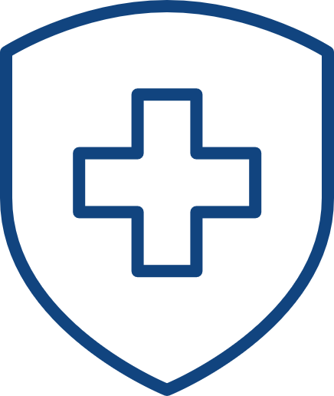

Digital Health, Social and Welfare Registers
NAME OF REGISTER | DATA INCLUDED IN REGISTER | KEEPER | ESTABLISHED IN COMPUTER FORMAT
Hospital discharge Register (HILMO) | Homes and institutions for the mentally disabled, including information on treatment | THL | 1967
Finnish Registry for Kidney Diseases | Diseases, type of treatment, and laboratory tests | ETK | 1964
Cancer Register | Cancer patient information from hospitals, pathology, laboratory measurements etc. | THL | 1953
Finnish Register of Visual Impairment | Patient´s visual ability | THL | 1983
National Infectious Diseases Register | Detailed information on cases in infectious diseases | THL | 1989
Register of Congenital Malformations | Infants and foetuses | THL | 1963
Drug Reimbursement Registers | Disease that is being treated and medication used | KELA | 1967
Medical Birth Register | Information on all births in Finland, from gestation week 22+0 or birthweight 500g | THL | 1987
Cause-of-Death Register | Intermediate case of death and contributing causes of death | STAT | 1969
Register on Occupational Disease | Diagnosis of occupational disease | FIOH | 1964
Drug Surveillance Register |  | FIMEA | 1982
National Sickness Insurance | Social benefit information | KELA | 1967
Register on Pensions | Work pension information, age of individual, type of pension | ETK | 1962
Finnish Employment Register | Work in private sector, work as entrepreneur an work without pay | ETK
Central Population Register | Relations (stillbirths are not registered) | VRK | 1973
Register on Social Assistance |  | THL | 1985
Child Welfare Register | Invidual-level Information on children taken into custody | THL | 1991
THL = National Institute of Health and Welfare ETK = Finnisk Centre KELA = Social Insurance Institution STAT = Statistics Finland for Pensions
FIOH = Finnish Institute of Occupational Health FIMEA = National Agency for Medicine ETK = The Finnish Kidney and Liver Association VRK = Central Population Register
17
comprehensive &
high-quality registers
Well-functioning
healthcare system
Electronic patient records
Digitally skilled & engaged people & culture of trust
Genomic data & biobanks
Government backing

Slide 10
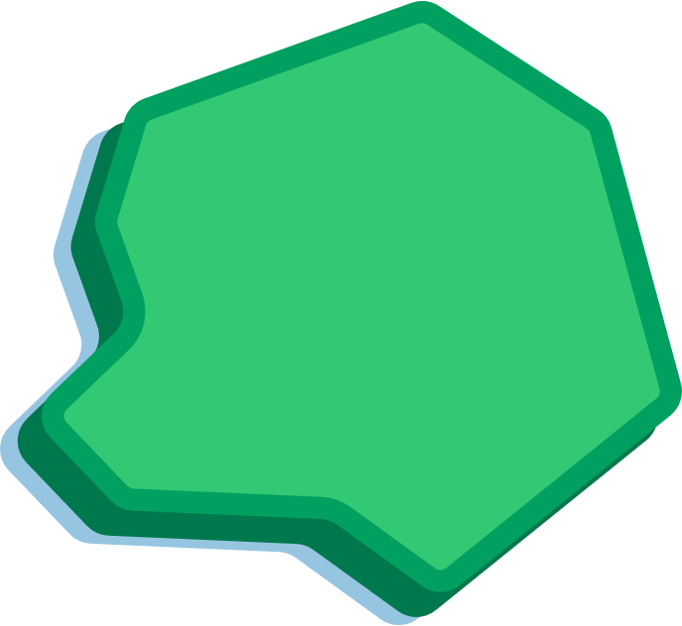





Advanced Data Infrastructure Facilitates the Data Access Process
FINDATA
Permit authority
Data combination
Data pseudonymization
Data
requests
BENEFITS OF FINDATA
A one-stop shop for the secondary use
of social and health data
Predefined timelines speeding up
the processing of requests and data release
Secure data analysis environment
to ensure better data privacy
Permit Application
REGISTRIES
CUSTOMER
Data
collection
BENEFITS OF FINGENIOUS®
A one-stop digital gateway to Finnish biobanks,
their collections and services
Perform quick sample and data queries
by browsing biobank collections
Reach all public biobanks in Finland with one feasibility and one access request
Only one material transfer agreement (MTA) needed
Possibility for recontacting donors for future studies
FINGENIOUS® BY FINBB
Service provider
Digital gateway to Finnish biobanks
Information about sample
and data availability
Coordinates feasibility studies, study permits, and sample
and data access
Data delivery
Data
requests
BIOBANKS
Data
collection
Well-functioning
healthcare system
Electronic patient records
Digitally skilled & engaged people & culture of trust
Genomic data & biobanks
Government backing
https://mediabank.businessfinland.fi/l/8DcLn5LqTKWP More info on FinData: https://youtu.be/0EykN6j9Sfg
Notes:
FINDATA – Social and Health Data Permit Authority
- A one-stop shop for the secondary use of health and social data.
- Grants data permits when data is required from multiple registers.
- Secure IT-environment & Help Desk.
Brings access to data in an effective and secure processing environment.
Eliminates overlapping administrative burden.
Enhances data protection and security.
Improves register data quality.
https://www.findata.fi/en/
https://stm.fi/en/genome-center

Slide 11
Advanced Data Infrastructure Facilitates the Data Access Process
GOVERNMENTAL SUPPORT
Act on the Secondary Use of Health and Social Data
Biobank Act
Genome Act
(in preparation)
Growth Programme for Health and Wellbeing
Public investments
Comprehensive Cancer Center
Neurocenter Finland
Genome Center
(in preparation)
Finnish Drug Discovery Centre
Well-functioning
healthcare system
Electronic patient records
Digitally skilled & engaged people & culture of trust
Genomic data & biobanks
Government backing
https://mediabank.businessfinland.fi/l/8DcLn5LqTKWP More info on FinData: https://youtu.be/0EykN6j9Sfg
Notes:
FINDATA – Social and Health Data Permit Authority
- A one-stop shop for the secondary use of health and social data.
- Grants data permits when data is required from multiple registers.
- Secure IT-environment & Help Desk.
Brings access to data in an effective and secure processing environment.
Eliminates overlapping administrative burden.
Enhances data protection and security.
Improves register data quality.
https://www.findata.fi/en/
https://stm.fi/en/genome-center

Slide 12


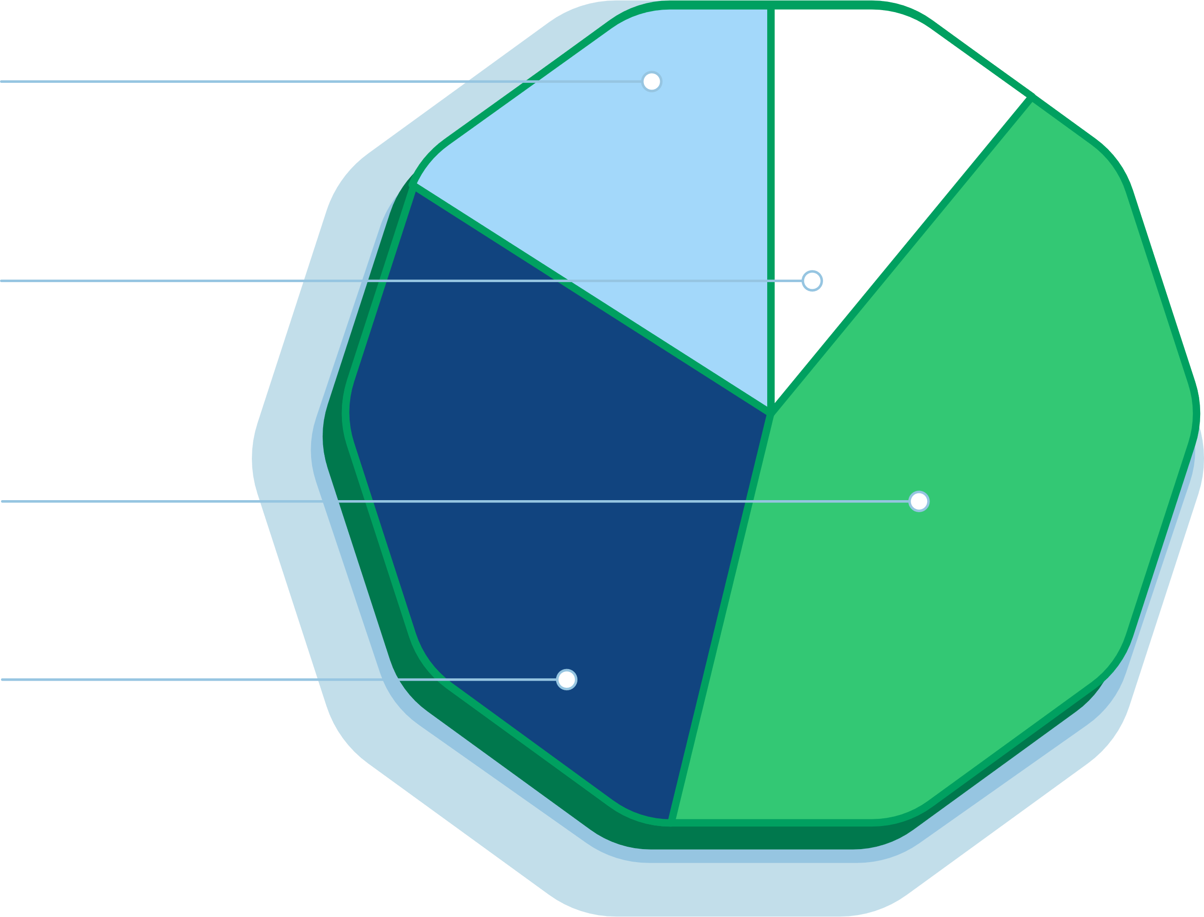
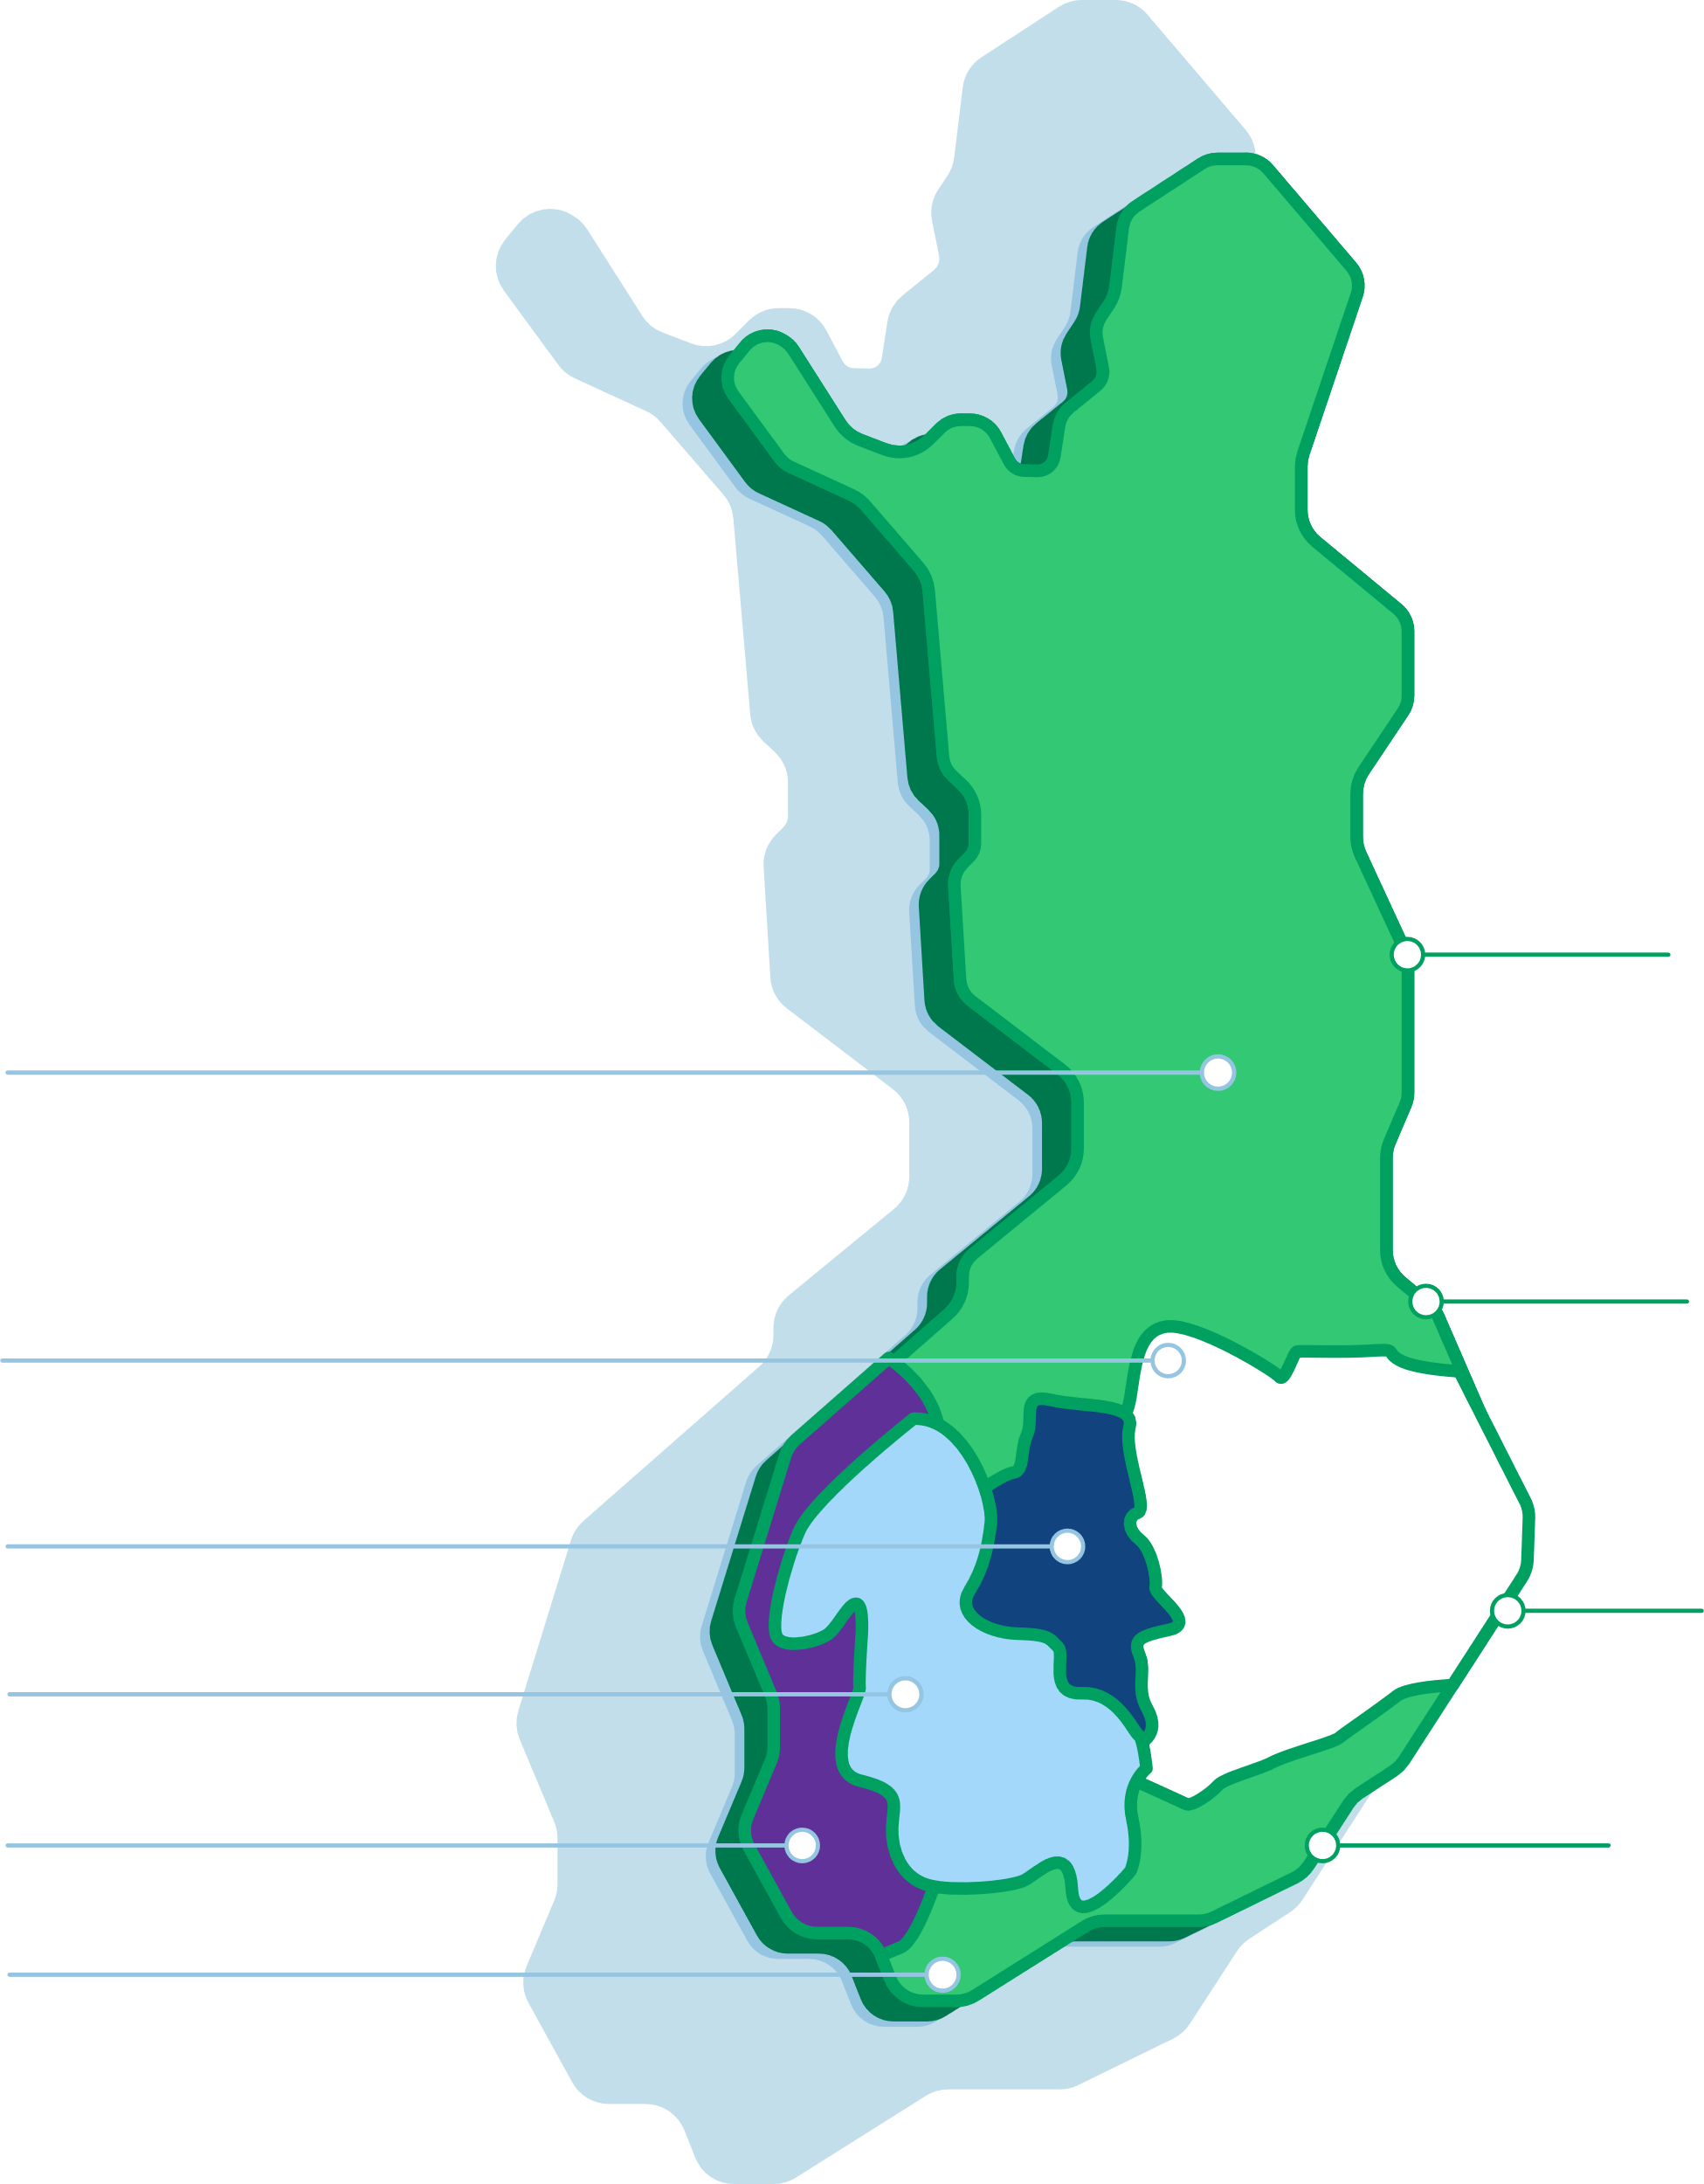

Finnish Biobanks Contain 4 Million Patients With 13 Million Samples*
SAMPLES
DNA
Plasma
Serum
Buffy coat
Other sample types: FFPE tissue (>11M samples), RNA, cells, CSF, liquid biopsies ( cfDNA), FF tissue, whole blood.
PATIENTS
POSSIBILITY FOR RECONTACTING DONORS Pre-screened patients with phenotype and genotype deep data can be recontacted for new biomedical studies. Up to 95% of all biobank donors give consent to be recontacted.
NATIONAL PATIENT RECALL SERVICE
Over 300,000 patients available for recontacting through FINBB's unique Fingenious® biobank service.
MULTIDISCIPLINED NETWORK OF EXPERTS Biobanks work in close collaboration with a network of clinicians covering all therapeutic areas.
DATA
A majority of the available clinical data is longitudinal EHR data.
Genome data
Basic demographic data (age, gender, diagnosis, etc.)
Data related to sample collection
Laboratory values
Hospital visits and stays
Procedure codes
Medication (administered or prescribed at the hospital)
Imaging
Lifestyle data
Questionnaire data
Data returned to the biobanks from research projects
Well functioning
healthcare system
Electronic patient records
Digitally skilled & engaged people & culture of trust
Genomic data & biobanks
Government backing
*All Finnish biobank operations are regularly supervised by the Finnish Medicine Agency (FIMEA).
Notes:
FinnGen brings together Finnish universities, hospitals and hospital districts, THL, Blood Service, biobanks and
international pharmaceutical companies and hundreds of thousands of Finns.
There are four main aims:
Aim 1: Produce medical innovations by combining health registry and genome data.
Aim 2: Support Finland to become a pioneer in biomedicine and personalised healthcare.
Aim 3: Create a co-operation model between public sector and healthcare industry.
Aim 4: Provide early access to new personalised treatments and health innovations for all Finns.
https://www.finngen.fi/en/purpose_and_goals

Slide 13

Finnish Biobanks Contain 4 Million Patients With 13 Million Samples*
Examples of samples stored in Finnish biobanks:
Regional biobanks:
Country-wide biobanks:
Serum >200,000
>400,000 sample donors with genome data
Biobank Borealis | Arctic Biobank University of Oulu
Hematological
Biobank
(FHRB Biobank)
Buffy coat >150,000
Biobank of Eastern Finland
Blood Service Biobank
DNA and/or
genome data >500,000
Central Finland Biobank
Finnish Clinical Biobank Tampere
THL Biobank
Plasma >340,000
Auria Biobank
Terveystalo Biobank Finland
Helsinki Biobank
Well-functioning
healthcare system
Electronic patient records
Digitally skilled & engaged people & culture of trust
Genomic data & biobanks
Government backing
*All Finnish biobank operations are regularly supervised by the Finnish Medicines Agency (FIMEA).
Notes:
FinnGen brings together Finnish universities, hospitals and hospital districts, THL, Blood Service, biobanks and
international pharmaceutical companies and hundreds of thousands of Finns.
There are four main aims:
Aim 1: Produce medical innovations by combining health registry and genome data.
Aim 2: Support Finland to become a pioneer in biomedicine and personalised healthcare.
Aim 3: Create a co-operation model between public sector and healthcare industry.
Aim 4: Provide early access to new personalised treatments and health innovations for all Finns.
https://www.finngen.fi/en/purpose_and_goals

Slide 14


A Science-Loving Government
Legislation / Growth programmes / Concrete actions
Well-functioning
healthcare system
Electronic patient records
Digitally skilled & engaged people & culture of trust
Genomic data & biobanks
Government backing
Notes:
Enabling legislation and growth strategies
Biobank Act (2013)
National Genome Strategy
Health Sector Growth Strategy for Research and Innovation Activities, Roadmap for 2016-2018
National Finnish eHealth and eSocial Strategy
Concrete actions
Establishment of National Genome Center
Establishment of Comprehensive Cancer Center
Establishment of ”Living Labs” in University Hospitals
The genome centre would serve as a one-stop shop service point for healthcare operators, research institutes and companies in all matters related to genomics. The centre would be responsible for the development of a national genomic database and support the efficient use of the database in patient treatment and scientific research.
The genome centre would be a centre of excellence that processes and stores data and enables its utilization.
https://stm.fi/en/genome-center

Slide 15




Count to Five – Count on Finland
Well-functioning
healthcare system
Electronic patient records
Digitally skilled & engaged people & culture of trust
Genomic data & biobanks
Government backing

Slide 16
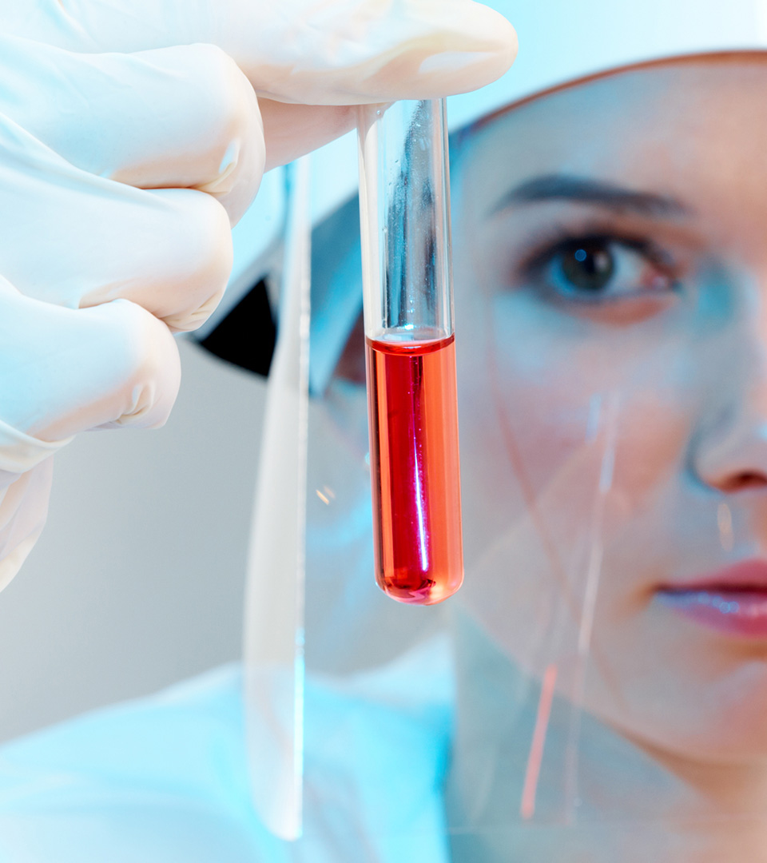
Land of Specialized Cancer Centers
National, local and private

Slide 17
Oncology/Hematology
The age structure of Finland: the number of elderly people is increasing rapidly leading to an increase in cancer cases
Cancer trials (industry sponsored) account for the largest share of open clinical studies in Finland
Others 5%
Metabolic/
Endocrinology
9%
Cardiovascular
12%
Oncology
42%
CNS
14%
Autoimmune/Inflammation
18%
200,000 150,000 100,000 500,000 0 500,000 100,000 150,000 200,000
Citeline Trialtrove, 2024

Slide 18
Oncology/Hematology
Trial phase
Disease
Several centers have expertise and willingness to perform studies from phase I until phase IV.
Citeline Trialtrove, 2024

Slide 19
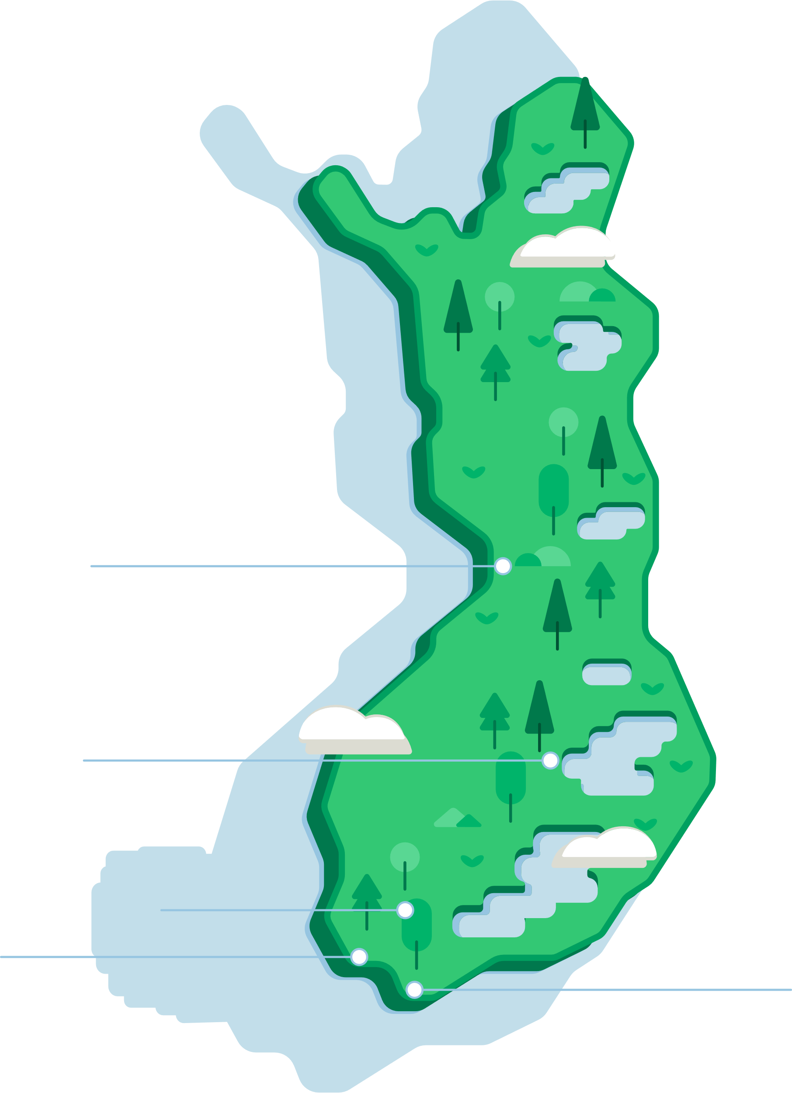



Oncology/Hematology
Finnish Cancer Center (FICAN) network covers the whole country.
5 OECI-accreditated university hospitals
  Helsinki University Hospital: Comprehensive Cancer Center (CCC)
  since 2014 (2nd in Europe and 1st in the Nordics). Also accreditated as
  a member of the European Reference on Rare Adult Solid Cancers (EURACAN).
Docrates Mehiläinen private cancer clinic (Helsinki)
  Finnish and international patients treated in Helsinki over 15 years
  Only Nordic private clinic. Good collaboration with university hospitals
Well-equipped cancer clinics with cancer-specific NGS panels in clinical practice
National cancer registry since 1953
Finland part of DRUP* study network (Finprove DRUP study)
*DRUP=drug rediscovery program. https://www.hus.fi/en/about-us/departments/comprehensive-cancer-center. https://www.docrates.com/en/treatments/new-drug-treatments-and-clinical-trials/.
https://www.nki.nl/news-events/news/dutch-nordic-alliance-for-precision-cancer-medicine-launched/. https://clinicaltrials.gov/study/NCT05159245. https://www.youtube.com/watch?v=giHAHKJUodY

Slide 20
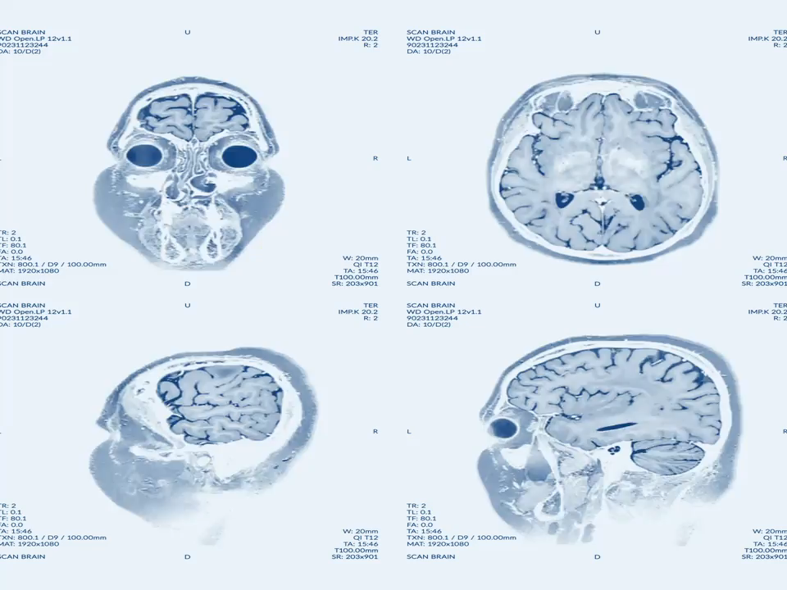
Land of Neurology Know-How
National collaboration and clinical trials

Slide 21
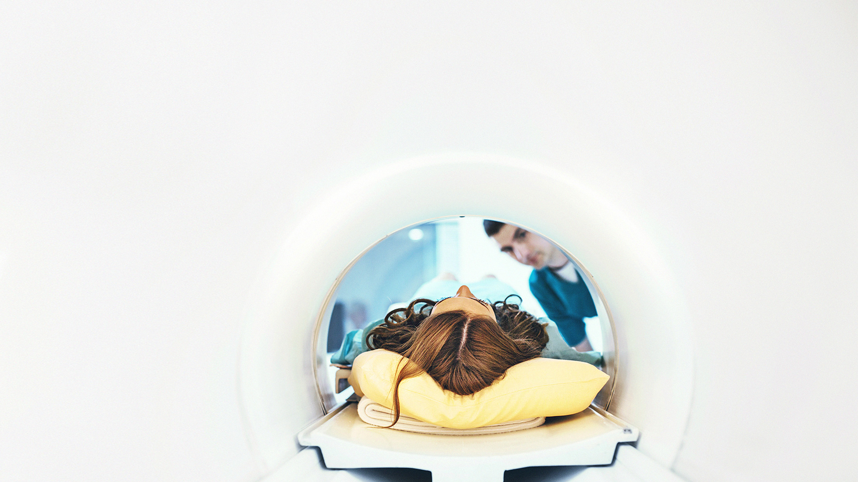
Clinical Trials in Neurology –
Strong Know-How & Top Expertise
Finland has strong know-how of neurological diseases and top expertise in medical imagining diagnostics.
The top areas: Alzheimer’s disease, mood disorders, epilepsy, insomnia, migraine
and cerebral infarction
Neurocenter Finland
Specialized centers, e.g.
Brain Research Unit Kuopio
Turku PET Centre
HUS Neurology Unit
Notes:
Clinical Trials in Neurology
Strong know-how of neurological diseases is combined with the top expertise in medical imagining and diagnostics in Finland
The top areas of research are Alzheimer’s disease, mood disorders, epilepsy, insomnia and cerebral infarction
CRST, Laura Airas, Juha Rinne & Mika Scheinin, http://www.crst.fi
Brain Research Unit, University of Eastern Finland, Merja Hallikainen, http://www2.uef.fi/en/crc/bru
Insomnia Clinic Helsinki, Markku Partinen, http://www.uniklinikka.fi
Coronaria Sleep Clinic, Henri Tuomilehti, http://www.coronariauniklinikka.fi
(CRST = Clinical Research Services Turku)

Slide 22

Turku PET Centre
A National Research Institute for the use of short-lived positron emitting isotopes in the field of medical research
  Diagnostic service for the whole country
Unique research infrastructure
  Including cyclotrons, radiochemistry production facilities, and imaging devices for human and animal use
  Large selection of PET-tracers for human and animal use
  GMP level production of numerous tracers
Image databank
  With >100,000 image sets that can be linked with the data from Auria Biobank and Auria Clinical Informatics
Notes:
CRST
Private Phase 1 unit with 2 fully equipped wards
Strong scientific background, Professor Emeritus of Pharmacology Mika Scheinin as a Chief Scientific Officer. Over 100 trials as PI, 340 articles
Juha Rinne, Professor of Neurotransmission, over 30 trials as PI, national coordinator in 10 and international PI in 9 trials, 330 articles
Laura Airas, Professor of Neuroimmunology, experienced PI, over 70 articles, main interest MS
Over 200 completed trials in patients and healthy volunteers since 1995
Over 50 international customers, including 7 of the 10 largest pharmaceutical companies
Proven track record in early phase development of drugs approved by FDA and EMA
Clinical trial experience in multiple different therapeutic areas
Special expertise in CNS, cardiovascular, metabolic disorders and oncology
High customer satisfaction – over 90% return rate

Slide 23
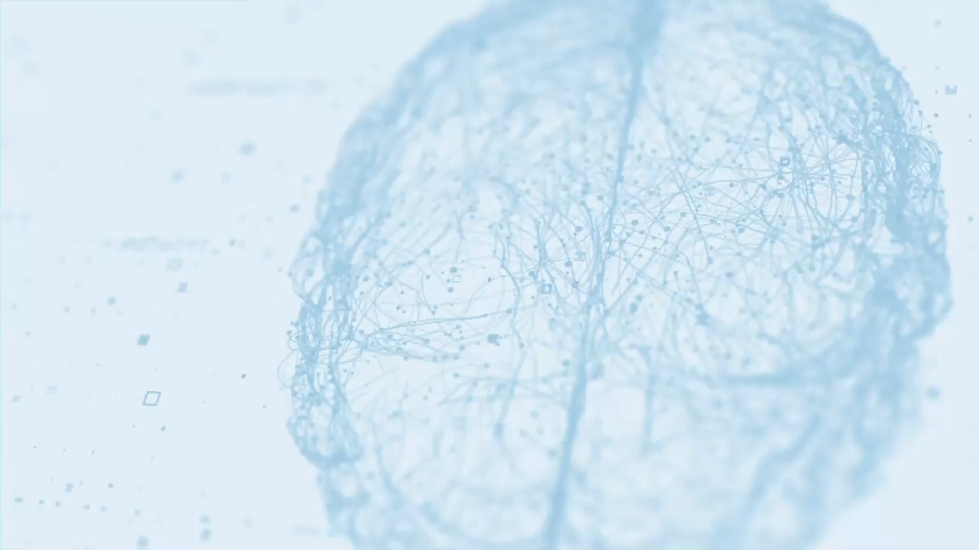

Brain Research Unit –
University of Eastern Finland
More than 30 years of experience in clinical trials, one of the largest academic neurological clinical trial units in the Nordic countries.
The staff includes doctors, research nurses, psychologists and a project specialist-controller
In addition to testing of drugs and devices intended for the treatment of neurological diseases, research services provides capabilities to study the genetic background of diseases, risk factors, mechanisms of origin, prevention, diagnostics and biomarker studies.
In terms of clinical imaging, cooperation is done with the KUH Imaging Center (structural neuroimaging, PET & SPECT) or private service providers (structural neuroimaging)
An accredited UEF Biomarker Laboratory operates in connection with the unit
Notes:
Brain Research Unit, University of Eastern Finland
Clinical Research Center committed to conduct high quality research in clinical science and in drug development in collaboration with local, national and international research groups and pharma industry
Research Director, MD, PhD Merja Hallikainen
30 years of experience and active national and international networks
Primary area of expertise: biomarker research and clinical drug research, diagnostics, prevention and treatment of neurodegenerative and cerebrovascular disorders
Excellent facilities and previous experience in studying the mechanisms of drugs in various model systems as well as in the preclinical phase, in studying the genetics and risk factors of complex diseases in large population-based cohorts, in developing biomarkers for neurodegenerative diseases and in conducting large-scale clinical trials

Slide 24

Land of
High-Quality Vaccine Research
National network, broad experience

Slide 25
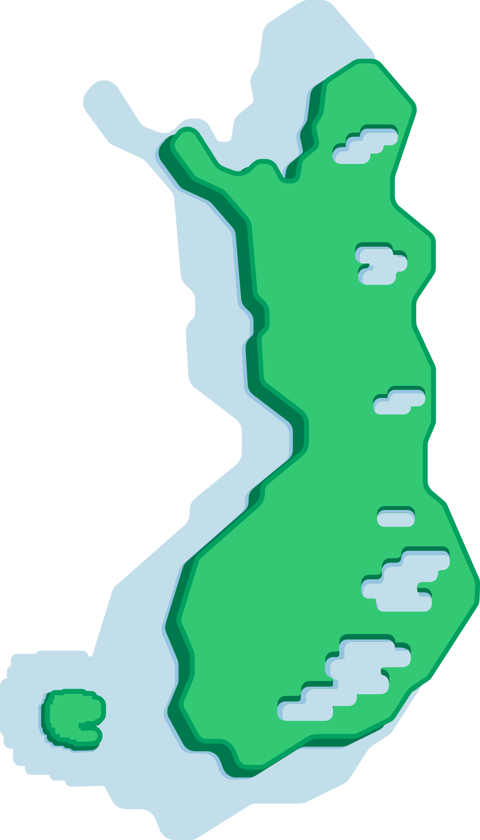

Vaccine Studies
Clinical site networks are located across Finland enabling large population-based enrollment of study subjects​
  Finnish Vaccine Research (FVR)
  Meilahti Vaccine Research Center (Mevac)
  Terveystalo
Despite being a small nation, it is possible to quickly recruit a large number of subjects
During 2019-2023, over 130,000 trial subjects in vaccine studies
Large variety of indications​
  Rota​virus, Pneumococcal​, Meningococcal ABCWY​, Herpes Zoster​, RSV​, Influenza, COVID, HPV, CMV, C-diff, Lyme disease, Dengue
Populations from pregnant women to newborns and
elderly people
Highly experienced in clinical vaccine studies in
all phases (I, II, III, IV) ​
FVR:
Helsinki, Turku, Tampere, Oulu, Kokkola, Järvenpää, Espoo, Seinäjoki
Mevac:
Helsinki
Terveystalo:
Oulu, Jyväskylä, Tampere, Turku, Helsinki

Slide 26
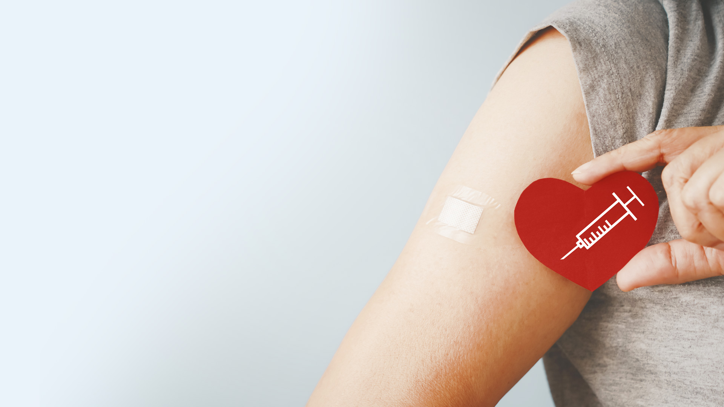
Vaccine Studies – Opportunities
Low drop-out rate, high retention rate
Recruitment reliability is high
GCP-trained staff, dedicated to CT only
(FVR & Mevac)
Innovations and technology, for example eISF, eICF
Fast start of the study after the regulatory authority approvals
Fluent and fast contract negotiations

Slide 27

Land of Pediatric Expertise
National network and specialized units

Slide 28
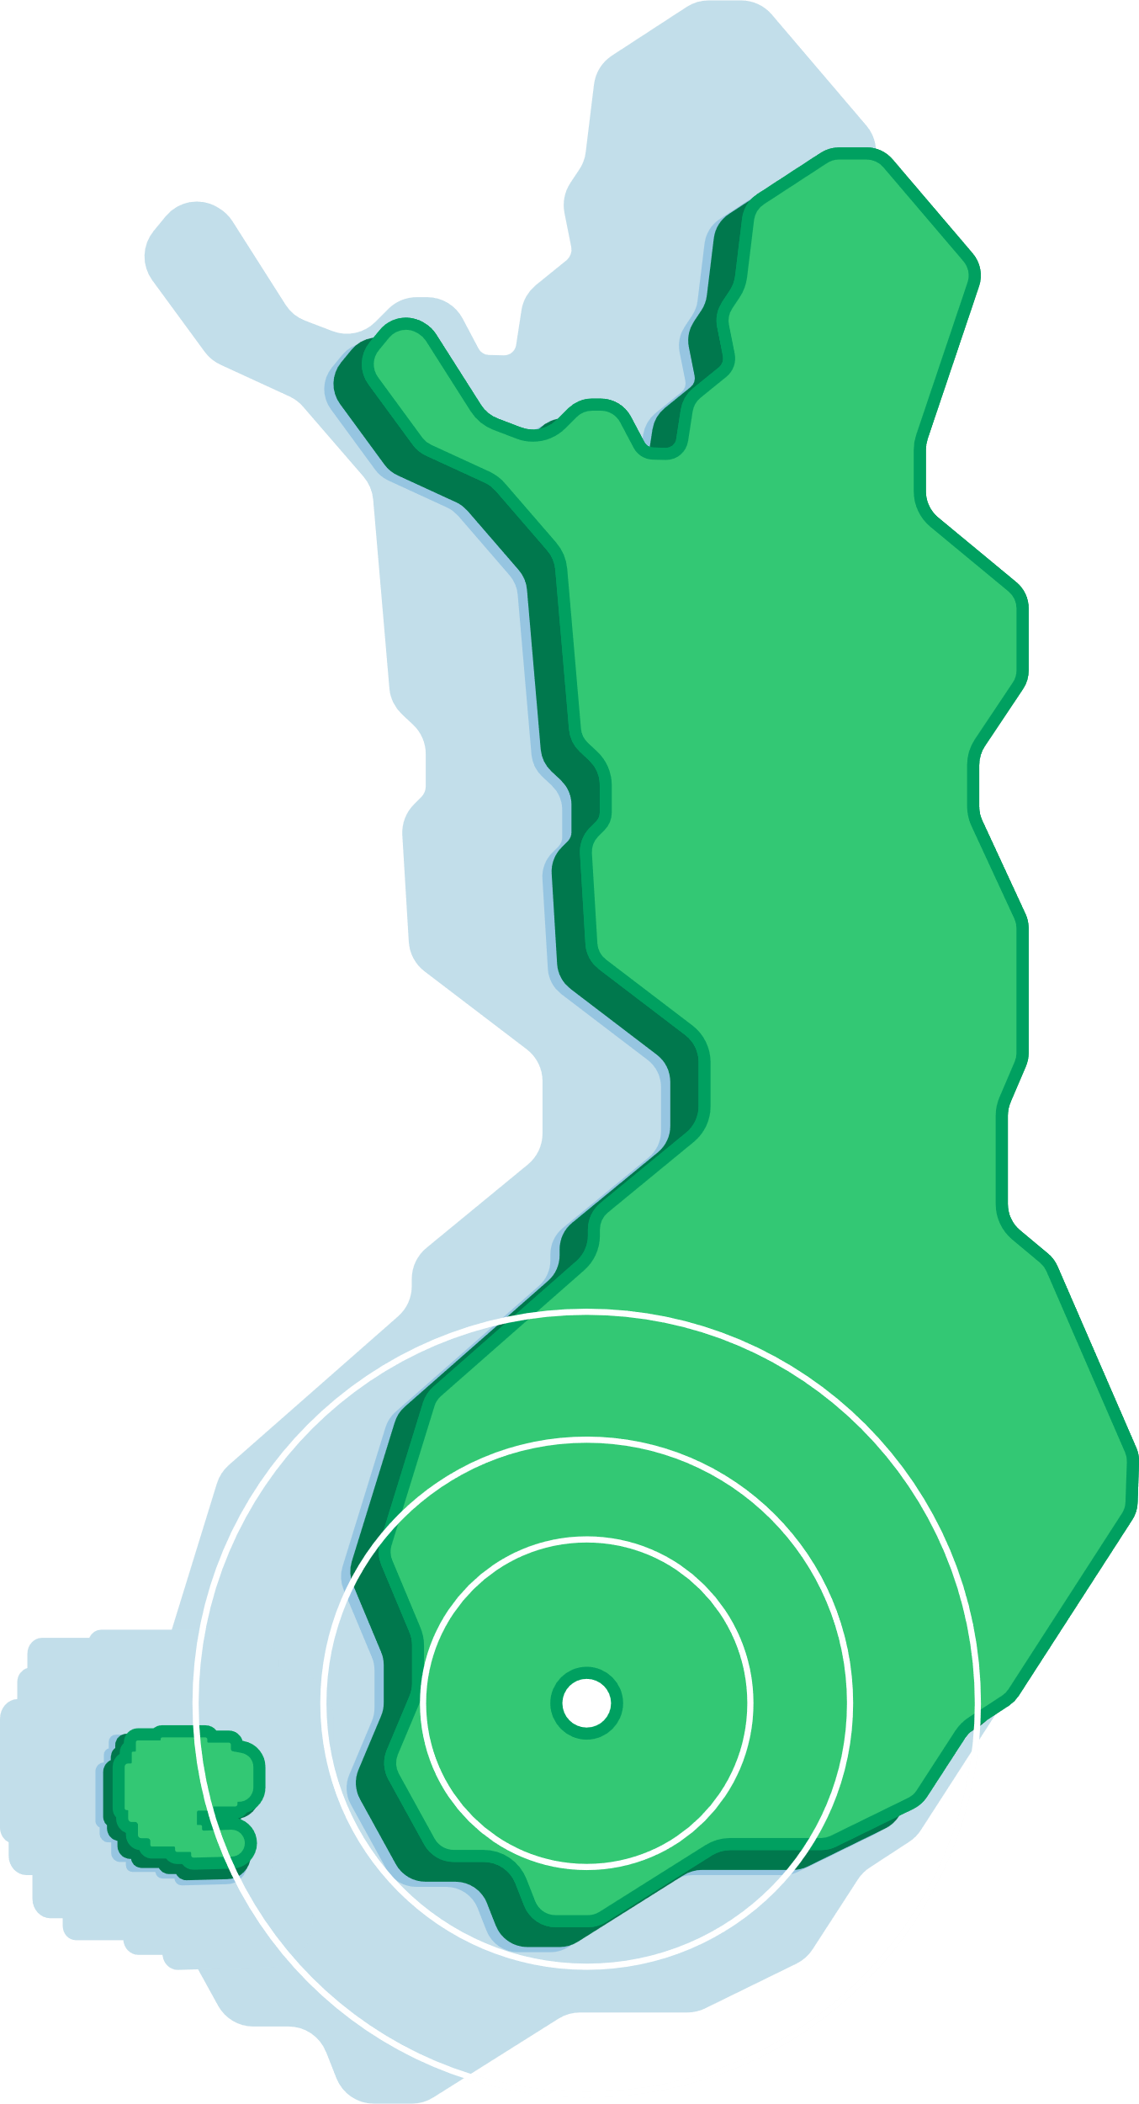
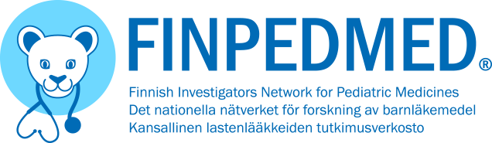

FINPEDMED, NORDICPEDMED, NOPHO
Finnish Investigators Network for Pediatric Medicines (FINPEDMED) operates in Finland and additionally manages a larger collaborative network, Nordic Investigators Network for Pediatric Medicines (NORDICPEDMED), sharing mutual Investigators´ Registry and the electronic Service Request portal, which are both administrated by FINPEDMED
All university hospital pediatric clinics are a part of Nordic Society of Paediatric Haematology and Oncology (NOPHO)
1,2
Million children
800 000
living inside
the outer circle
Key centers
Helsinki, Tampere, Turku
https://finpedmed.fi/en/. NOPHO – Nordic Society of Paediatric Haematology.
PeeTU | TamCAM - Tampere Center for Child, Adolescent and Maternal Health Research | Tampere Universities (tuni.fi)
Notes:
NordicPedMed has a European level connection through national network memberships to the European Network of Pediatric Research at the European Medicines Agency, Enpr-EMA.
The ultimate aim of NordicPedMed is to develop a Nordic network of investigators, centers and the national networks with recognized expertise in performing clinical studies on children and increase cooperation both on a Nordic and European level.
The network’s objectives are to help meet the therapeutic needs of children by facilitating development, increasing knowledge and communicating information on the appropriate use of new medicines, medicines currently available, and other therapies for the pediatric population.
NordicPedMed Office:
Helsinki University Hospital, Department of Children and Adolescents, Finland.

Slide 29

Pediatric Clinics in Finland
78 ongoing pediatric clinical trials across phase I–IV (2024)
Therapeutic Area
Trialtrove®, 2024
Notes:
Pediatric clinics of the university hospitals:
Helsinki University Hospital; Children and Adolescents
New Children´s Hospital, Clinical Trial Unit (CTU), located at Park Hospital facilities
Tampere University Hospital, Department of Paediatrics
Paediatric Early Phase Clinical Trials Unit, PeeTU
Turku University Hospital, Department of Paediatrics and Adolescent Medicine
Oulu University Hospital, Clinic for Children and Adolescents
Kuopio University Hospital, (Department of Paediatrics)

Slide 30
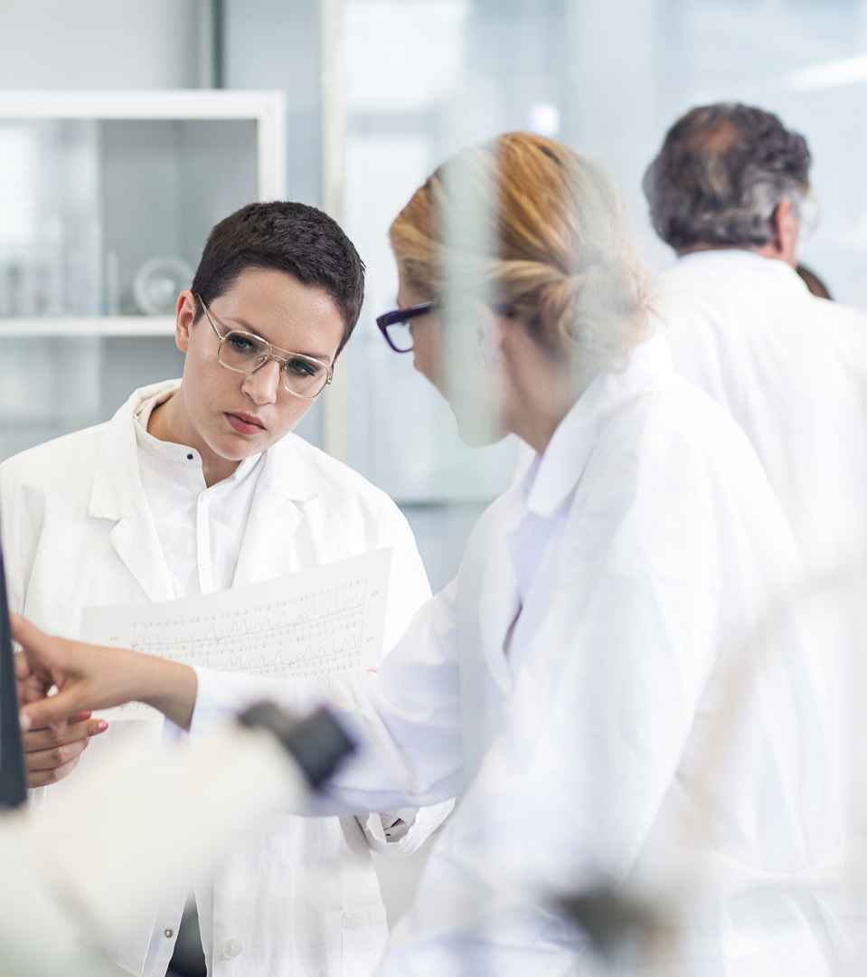

Land of Phase I Research Specialists

Slide 31
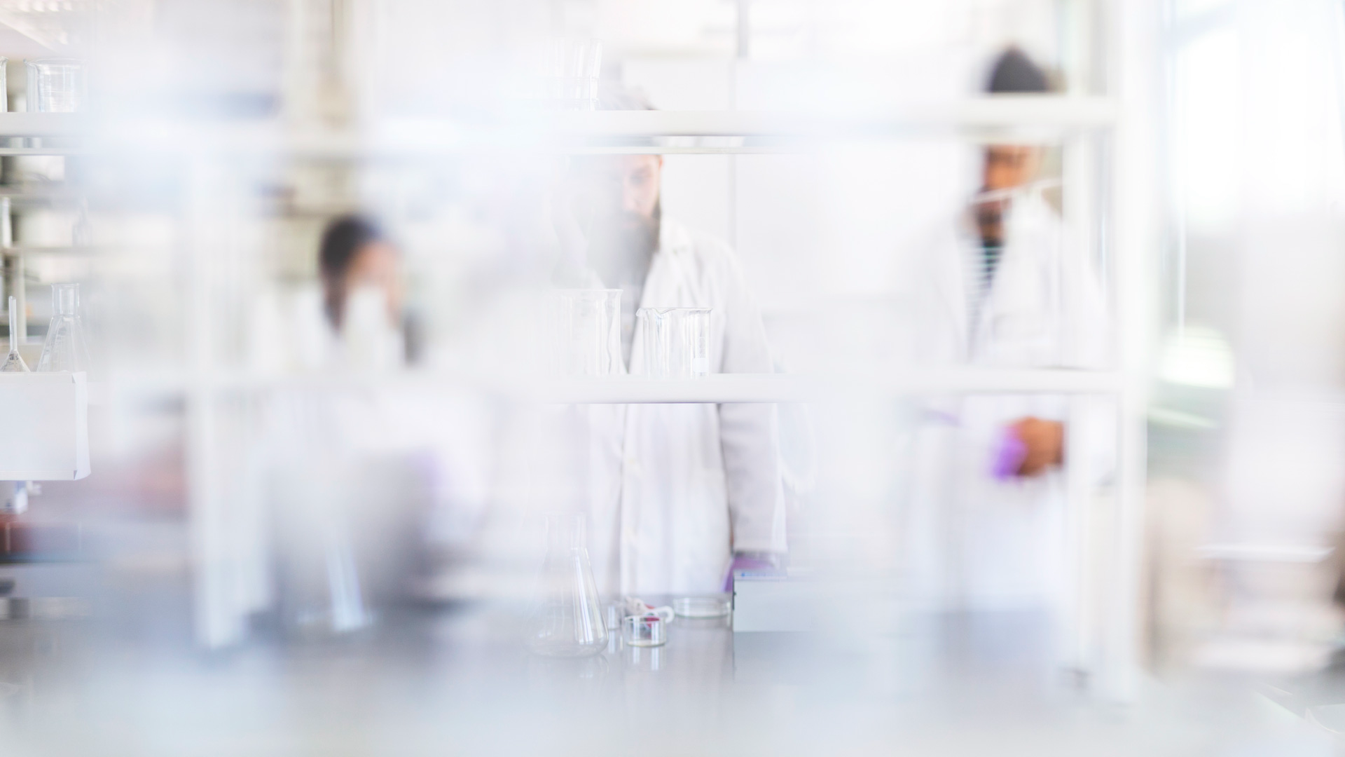
Land of Phase I Expertise
Finland has specialized research centers dedicated to clinical trials, equipped with state-of-the-art facilities and technologies. These centers are tailored to meet the unique demands of phase I studies, providing
a controlled environment for early-stage studies.
Despite a small population, Finland excels in efficient participant recruitment and retention due to strong healthcare infrastructure and collaboration with local healthcare providers. This ensures the success of phase I trials.
Knowledge and capability to perform phase I studies e.g. in the following research centers: CRST, FONK, HUS
  16 ongoing phase I studies 2024
  16 ongoing phase I/II studies
Therapeutic Area
Trialtrove®, 2024

Slide 32
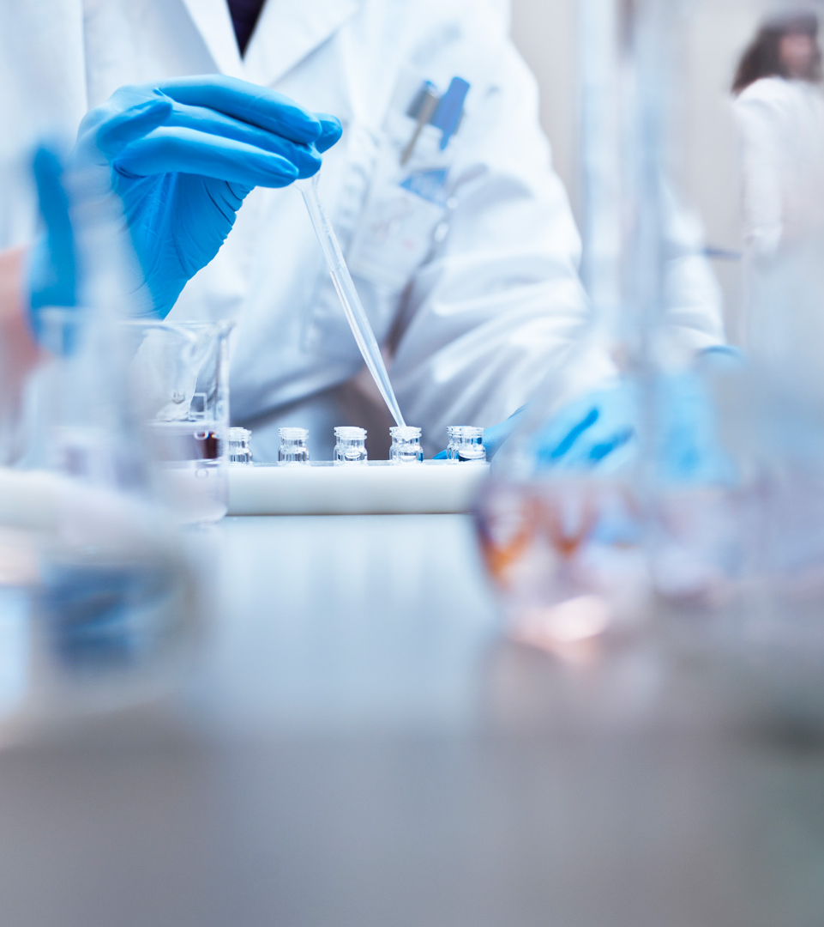
Research Opportunities in Private
Sector
17
clinic hospitals
370
clinics
Case Terveystalo
Notes:
Terveystalo is the largest healthcare service company in Finland
3,5 million visits to physicians per year
Diagnostics: laboratory,
MRI, ultrasound, radiology
200 000 mammographies per year
Also hospital services
Clinical trials and biobank
Sales 1 B€
Fast recruitment: Consenting customers / patients to be contacted for clinical trials
Consent enables pre-screening, contacting potential study subjects and provides an opportunity to participate in clinical or vaccine trials or to the give a sample for biobank
Very cost-effective way of recruiting trial subjects
100 000+ biobank consents
Almost 3000 new biobank consents per week via an electronic form

Slide 33
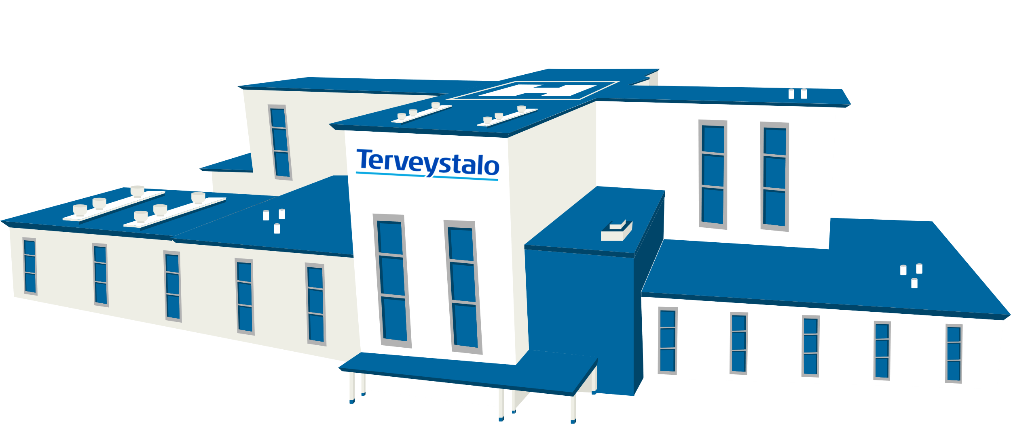
Terveystalo – The Largest Healthcare Service Company in Finland
3,5 million visits to physicians per year
Clinical trials
trials@terveystalo.com
25,000
corporate customers
1 300,000
individual customers
700,000
people receiving
occupational healthcare services
12%
of appointments with
physicians in Finland
Notes:
3,5 million visits to physicians per year
Diagnostics: laboratory,
MRI, ultrasound, radiology
200 000 mammographies per year
Also Hospital services
Clinical trials and biobank
Sales 1 B€
Fast recruitment: Consenting customers / patients to be contacted for clinical trialsConsent enables pre-screening, contacting potential study subjects and provide an opportunity to participate in clinical or vaccine trials or to the give a sample for biobank
Very cost-effective way of recruiting trial subjects
100 000+ biobank consents
Almost 3000 new biobank consents per week via an electronic form

Slide 34
Clinical Research Services Turku – CRST Oy
Two centrally located sites: Helsinki and Turku, accessible to over 50% of the Finnish population
CRST has conducted over 250 trials, including over
100 phase I trials
CRST scientific team is well-known for their strong scientific rigor
Proven track record in development of drugs approved by EMA and FDA
Offers services for later phase trials – SMO model
Own phase I units support first-in-human trials
– full service model
General public trust in scientific research supports recruitment
Turku
Helsinki

Slide 35
THANK
YOU

